Slide 1
Optimal Contact Collection at MTA Stations for WTWY Gala
Created By:
Sam Adams
Luke Von Glan
Rishi Sheth
Skyler Lehto
9/28/18

Slide 2
Objective and Method
Determine best stations to place street teams for WTWY Gala
Filter MTA turnstile data by:
Location
Lower Manhattan tech zone
Timeframe
Spring 2016-18
Identify highest traffic stations

Slide 3
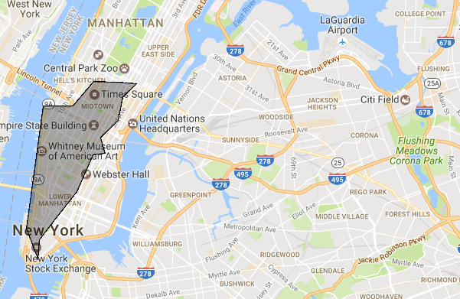
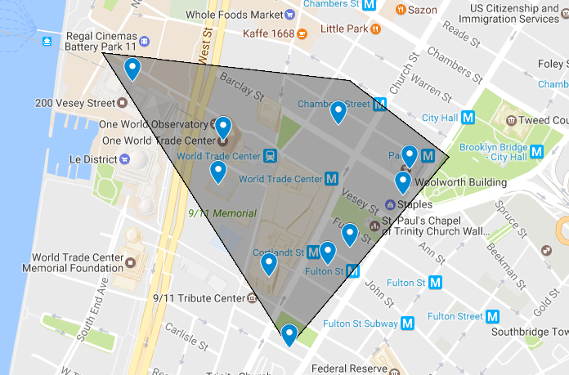
NYC’s “Silicon Alley”
96 % of largest tech firms
10% of largest firms
Source: https://www.builtinnyc.com/2016/12/13/big-tech-companies-nyc-locations

Slide 4
Assumptions
Tech employees most likely to support WTWY
Smaller tech firms located near large ones
Stations are busiest right before/after work

Slide 5
Data Collection and Processing - Location
Retrieve station coordinates
Filter out stations not in ‘Silicon Alley’
Identify highest priority station locations (those next to smaller cluster of many tech firms)

Slide 6
Data Collection and Processing - Traffic
Collect turnstile data
Filter turnstiles that are outside of map coordinates
Find remaining stations with highest traffic
Reconcile station name differences between station entrance and turnstile data sources
Notes:
Need to clearly identify

Slide 7
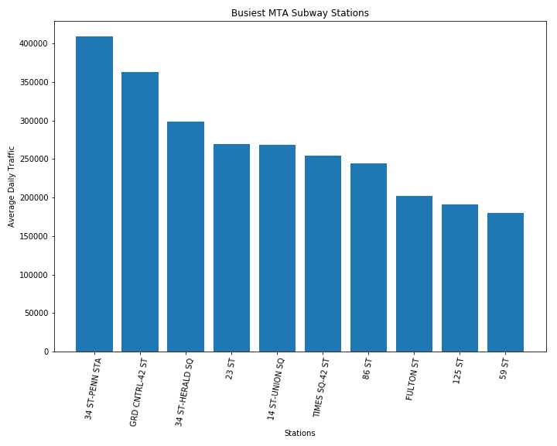
Highest Traffic Stations
Average Daily Traffic calculated from sum of daily entries and exits
Send people to highest traffic stations within tech zone

Slide 8
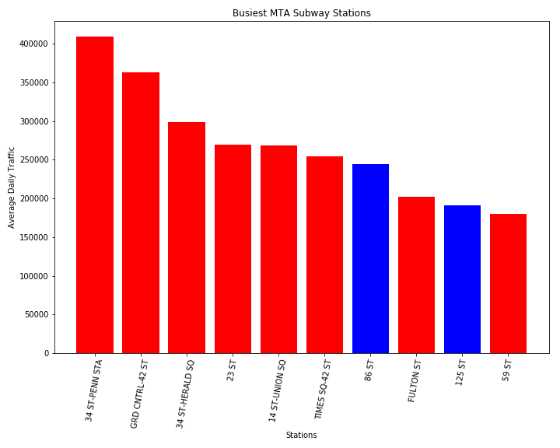
Highest Traffic Stations
Average Daily Traffic calculated from sum of daily entries and exits
Send people to highest traffic stations within tech zone

Slide 9
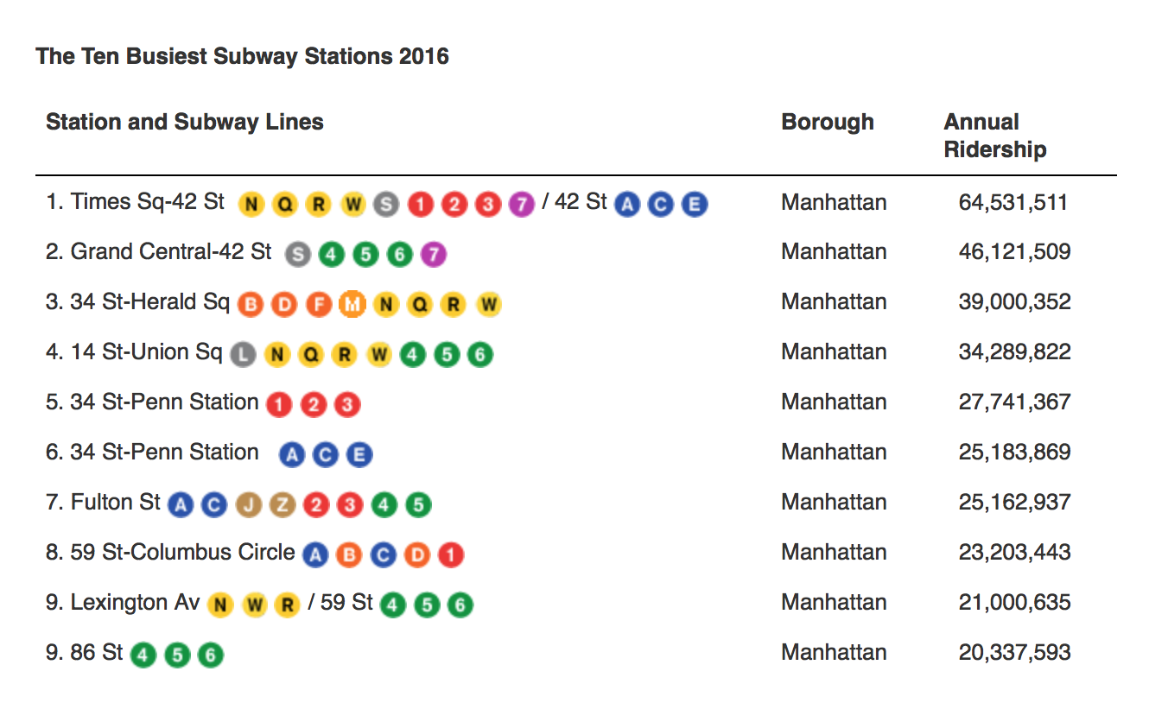
Sanity Check
The busiest subway stations according to MTA’s website:
Source: http://web.mta.info/nyct/facts/ffsubway.htm
Notes:
Daily averages in this slide are on the same order of magnitude as the numbers we saw in our own analysis.

Slide 10
Recommendations for WTWY
Target core Silicon Alley stations:
Fulton St & Chambers St
Target busiest Silicon Alley stations:
Grand Central & Penn. Station
14th St - Union Square
Send street team to all Silicon Alley stations if possible
Notes:
Recommendations: “If we had to pick one”

Slide 11
Appendix A - More to Investigate
Are there stations where many tech employees live nearby?
Best to send extra people to high traffic stops with many entrances?
Areas with high density of start-ups/small tech firms?
Optimal timespan before gala to approach people?

Slide 12
Appendix B - Highest Traffic Stations
The following stations are ranked from highest to lowest traffic in Silicon Alley:
Heuristic: Advertise west of Q & R lines in middle and lower Manhattan
1)_34th St - Herald Sq. | 5) Fulton St | 9) Chambers St
2) 14th St - Union Square | 6) 59th St | 10) 28th St
3) Times Square - 42nd St | 7) Canal St | 11) 50th St
4) 23rd St | 8) 14th St | 12) Wall St

Slide 13
Appendix C - Data Cleaning
Issues in Data Analysis:
Current method for string matching in station names is crude.
Initial “in Manhattan” filtration missed a few high-traffic stations, such as:
Grand Central
34th St & Penn

